Slide 1
Northwestern Mutual Speaker Event

Slide 2
Financial Advising
10/7/2019
Josh Kosnick Tia Tidd
Managing Partner Director of Internship Development
Kelsey Reed Junior Coleman
Campus Recruiter Financial Advisor

Slide 3
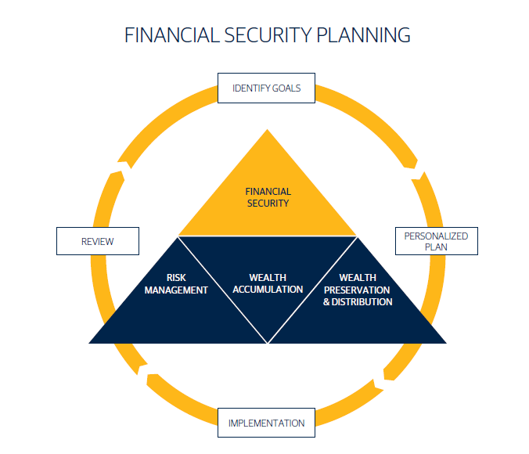
Financial Advising with Professional Athletes
Understanding their contract
Start early
Budgeting & Paying a Salary
Passive vs. Earned Income
Taxation

Slide 4
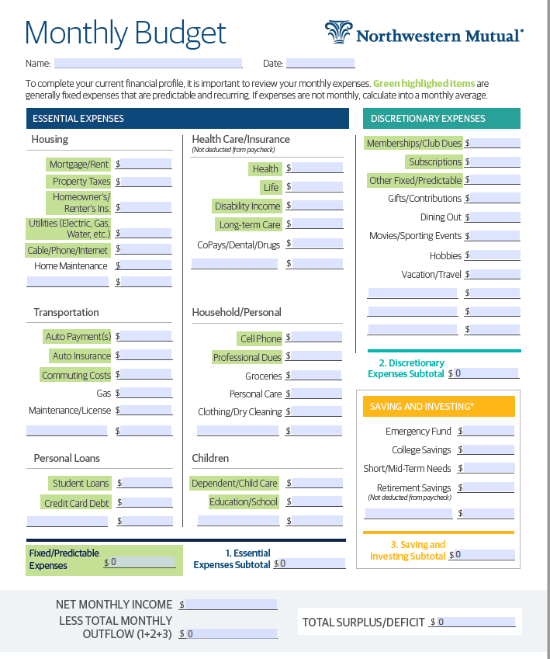
Finance 101
Budgeting
Emergency Funds
Student Loans
Private vs. Federal
Repayment Options

Slide 5
Networking

Slide 6
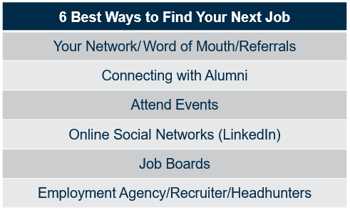
Career Searching

Slide 7
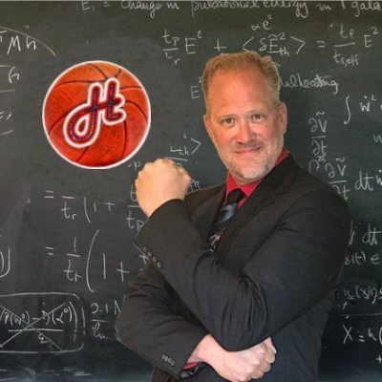
Next Event This Wednesday
Erik Haslam Speaker Event
NCAA Basketball Analytics Expert
Wednesday, October 9th
7:00 in Grainger 1195

